Slide 1
Module 10
Maintaining and Updating Windows Server 2016
Notes:
Presentation: 110 minutes
Lab: 120 minutes
After completing this module, students will be able to:
Describe the purpose of Windows Server Update Services (WSUS) and the requirements to implement WSUS.
Manage the update process with WSUS.
Describe the purpose and benefits of Windows PowerShell Desired State Configuration (DSC).
Describe the monitoring tools available in Windows Server 2016.
Use Performance Monitor.
Manage event logs.
Required materials
To teach this module, you need the Microsoft PowerPoint file 20740C_12.pptx.
Preparation tasks
To prepare for this module, you should:
Read all of this module’s materials.
Practice performing the demonstrations and labs.
Work through the Module Review and Takeaways section to determine how you will use the information to reinforce student learning and promote knowledge transfer to on-the-job performance.
As you prepare for this class, it is imperative that you complete the labs yourself. This gives you an understanding of how the labs work and the concepts that each covers, so that you can provide meaningful hints to students who might have issues. Furthermore, it will help guide your lecture to ensure that you discuss the concepts that the labs cover.
20740C
12: Managing, monitoring, and maintaining virtual machine installations

Slide 2
Module Overview
WSUS overview and deployment options Update management process with WSUS Overview of Windows Server 2016 monitoring tools Using Performance Monitor Monitoring event logs
Notes:
20740C
12: Managing, monitoring, and maintaining virtual machine installations

Slide 3
Lesson 1: WSUS overview and deployment options
What is WSUS? WSUS server deployment options The WSUS update management process Server requirements for WSUS Configuring clients to use WSUS
Notes:
Briefly describe the lesson content.
Question
What are some benefits of using WSUS to manage Windows updates?
Answer
Answers will vary depending on the students’ experiences. Some benefits are:
Ability to deploy updates to non-production environments for testing.
Ability to deploy updates on a staggered schedule.
Better control of the Internet bandwidth while downloading updates.
20740C
12: Managing, monitoring, and maintaining virtual machine installations

Slide 4


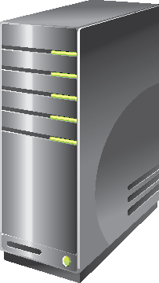

What is WSUS?
Microsoft Update website
Automatic updates
Server running
WSUS
Test clients
LAN
Internet
Automatic updates
Notes:
This topic introduces students to WSUS. Make sure that students understand the capabilities and limitations of WSUS. WSUS obtains updates for Windows operating systems and for other Microsoft app products such as Microsoft SQL Server. However, WSUS does not provide updates for non-Microsoft software.
20740C
12: Managing, monitoring, and maintaining virtual machine installations

Slide 5
WSUS server deployment options
WSUS implementation:
Single server
Multiple servers
Disconnected servers
WSUS hierarchies:
Autonomous mode
Replica mode
WSUS database:
Windows Internal Database
SQL Server database
Notes:
Explain that you only require SQL Server databases when your technical requirements include Network Load Balancing (NLB). Make sure that students understand that Microsoft supports a single WSUS server for every 100,000 clients. However, they need to consider the bandwidth, connectivity, and availability requirements of their individual environment to determine the number of servers to use.
Additional Reading: For more information on determining capacity for WSUS servers, refer to “Determine Capacity Requirements” at: http://aka.ms/Shljv4
20740C
12: Managing, monitoring, and maintaining virtual machine installations

Slide 6
The WSUS update management process
Phase 1: Assess
Set up production environment
Assess
Phase 4: Deploy
Phase 2: Identify
Deploy
Update management
Identify
Discover new updates
Determine if updates are relevant
Approve and schedule updates
Review process
Evaluate and Plan
Phase 3: Evaluate and plan
Test updates
Determine how to update production environment
Notes:
Explain the four phases that we recommend for the update management process: assess, identify, evaluate and plan, and deploy. Emphasize that it is essential to repeat the update management process on an ongoing basis as new updates become available that can enhance and protect the production environment.
Explain that each phase has different goals and methods for using WSUS features to ensure success during the update management process. It is important to note that you can employ many of the features in more than one phase.
20740C
12: Managing, monitoring, and maintaining virtual machine installations

Slide 7
Server requirements for WSUS
Software requirements:
IIS
Microsoft .NET Framework 4.6 or newer
Microsoft Report Viewer Redistributable 2008 or newer
SQL Server 2012 SP1, SQL Server 2012, SQL Server 2008 R2 SP2, SQL Server 2008 R2 SP1, or WID
Hardware requirements:
1.4 GHz or faster x64 processor
2 GB of RAM or greater
10 GB available disk space (40 GB or greater is recommended)
Notes:
Windows Server 2016 includes WSUS as a server role. If you install the WSUS server role, then all software prerequisites install automatically, including the Windows Internal Database (WID), if required.
20740C
12: Managing, monitoring, and maintaining virtual machine installations

Slide 8
Configuring clients to use WSUS
Use a GPO to:
Configure automatic updates
Specify intranet Microsoft Update service location
For computers running Windows 8 and Windows Server 2012, you can use Automatic Maintenance to control the update process
For computers running older operating systems, you should:
Automatically download updates
Automatically install updates
Beginning with Windows 10, you can defer updates for up to one month
Notes:
Show students how to set up a Group Policy Object (GPO) for WSUS. Make sure you explain the Automatic Maintenance feature in Windows 8 and Windows Server 2012 and newer. Describe how it reduces resource consumption and saves power. In addition, discuss the deferment feature for Windows 10 and newer.
20740C
12: Managing, monitoring, and maintaining virtual machine installations

Slide 9
Lesson 2: Update management process with WSUS
WSUS administration What are computer groups? Approving updates Configuring automatic updates Demonstration: Deploying updates by using WSUS WSUS reporting WSUS troubleshooting
Notes:
Question
Why would you use Group Policy to configure Windows systems to use WSUS?
Answer
Answers will vary depending on the students’ experience. Answers could include that using Group Policy to configure Windows Updates helps to prevent configuration errors.
20740C
12: Managing, monitoring, and maintaining virtual machine installations

Slide 10
WSUS administration
You can use the WSUS administration console to:
Manage updates
Configure computer groups
View computer status
View synchronization information
Configure and view WSUS reports
Configure WSUS settings and options
In Windows Server 2016, WSUS also includes Windows PowerShell cmdlets for administration
Notes:
Explain the different management tasks that you can perform in the WSUS administration console.
Open the WSUS administration console on LON-SVR1, and show students where you perform some of the key configuration tasks. Focus on where computer groups are located and created, and explain how to view and approve or decline updates.
20740C
12: Managing, monitoring, and maintaining virtual machine installations

Slide 11
What are computer groups?
You can use computer groups to organize WSUS clients
The default computer groups include:
You can create custom computer groups to control how updates are applied
All computers
Unassigned computers
Notes:
Explain to the students that computers are always assigned to the All Computers group, and remain assigned to the Unassigned Computers group until you assign them to another group. Point out that computers can belong to more than one group.
You can set up computer groups in hierarchies. For example, the groups Payroll and Accounts Payable can be below the Accounting group. Updates that you approve for a higher group will be deployed automatically to lower groups, and to the higher group itself. Thus, if you approve Update1 for the Accounting group, the update will be deployed to all the computers in the Accounting group, in addition to all the computers in the Payroll and Accounts Payable groups.
20740C
12: Managing, monitoring, and maintaining virtual machine installations

Slide 12
Approving updates
Updates can be:
Approved automatically, but it is not recommended
Declined if they are not needed
Removed if they cause problems
You should test updates before they are approved for production
Notes:
Stress to students the importance of testing updates before they apply them in a production environment. Mention that students can use a custom computer group for a pilot group when testing.
You can also discuss with students what type of updates they should approve. For example, you might consider driver updates optional, but you should apply security updates in most cases.
Consider showing the students the approval process in the Update Services console on LON-SVR1.
20740C
12: Managing, monitoring, and maintaining virtual machine installations

Slide 13
Configuring automatic updates
You must configure the client computers to use the WSUS server as the source for updates
You can use Group Policy to configure clients, including the following settings:
Update frequency
Update installation schedule
Automatic restart behavior
Default computer group in WSUS
Notes:
Explain to students that WSUS clients must be configured to use the WSUS server as a source for obtaining updates. After this configuration, the WSUS clients will no longer obtain updates directly from Microsoft Update.
As an informal demonstration, open Group Policy Management on LON-DC1, edit a GPO, and show students the settings and where to find them.
20740C
12: Managing, monitoring, and maintaining virtual machine installations

Slide 14
Lab A: Implementing WSUS and deploying updates
Exercise 1: Implementing WSUS Exercise 2: Configuring update settings Exercise 3: Approving and deploying an update by using WSUS
Logon Information
Virtual machines: 20740C-LON-DC1
20740C-LON-SVR2
20740C-LON-SVR4
20740C-LON-CL1
User name: Adatum\Administrator
Password: Pa55w.rd
Estimated Time: 60 minutes
Notes:
Note: Installing the update in Exercise 3 can take several minutes. You may choose to continue with Lesson 3 and ask students to complete this lab before starting Lab B.
Use these questions and answers to discuss this lab with the students.
Question
You created a separate group for the Research department. Why would you configure a separate group for some of your organizations’ computers?
Answer
The Research department might have special considerations or security practices that require a different process for testing and approving updates than the rest of the organization. In addition, other departments might have administrators with the responsibility of managing the update approval process.
Question
What is the advantage of configuring a downstream WSUS server?
Answer
If the main WSUS server and the downstream server are connected by a slow wide area network (WAN) connection, the downstream WSUS server only downloads the updates once for the client computers it services. Otherwise, each client computer would download the update individually over the WAN connection from the main WSUS server.
Exercise 1: Implementing WSUS
Your organization has a WSUS server called LON-SVR2, which is located in the head office. You need to install the WSUS server role on LON-SVR4 at a branch location. LON-SVR4 will use LON-SVR2 as the source for Windows Update downloads. The installation on LON-SRV4 will use the Windows Internal Database for the deployment.
Exercise 2: Configuring update settings
You need to configure the Group Policy settings to deploy automatic WSUS settings to client computers. With the WSUS role configured on LON-SVR4, you must ensure that the Research Department has its own computer group in WSUS on LON-SVR4. You must also configure client computers in the Research organizational unit (OU) to use LON-SVR4 as their source for updates.
Exercise 3: Approving and deploying an update by using WSUS
After you have configured the Windows Update settings, you can view, approve, and then deploy required updates. You want to use LON-CL1 as a test case for the Research Department. You will approve, deploy, and verify an update on LON-CL1 to confirm the proper configuration of the WSUS environment.
20740C
12: Managing, monitoring, and maintaining virtual machine installations

Slide 15
Lesson 4: Overview of Windows Server 2016 monitoring tools
Overview of Task Manager Overview of Performance Monitor Overview of Resource Monitor Overview of Reliability Monitor Overview of Event Viewer Monitoring a server with Server Manager
Notes:
Provide an overview of the topics that you will discuss with students in this lesson.
Question
Which of the tools discussed in this lesson would you use to check which resources an application is using?
Answer
Answers will vary based on the students’ experience, but could include:
Task Manager, because it provides an overview of the resources that an application is using.
Performance Monitor, because it provides a view of the historical information.
Resource Monitor, because it provides a more detailed view of resource usage.
20740C
12: Managing, monitoring, and maintaining virtual machine installations

Slide 16
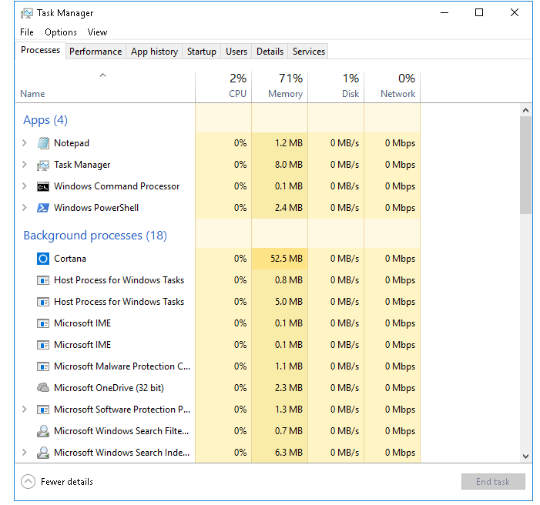
Overview of Task Manager
Task Manager helps you to identify and resolve performance-related issues
Notes:
Note: This topic has two additional slides.
Consider demonstrating Task Manager as you discuss the contents of each tab.
20740C
12: Managing, monitoring, and maintaining virtual machine installations

Slide 17
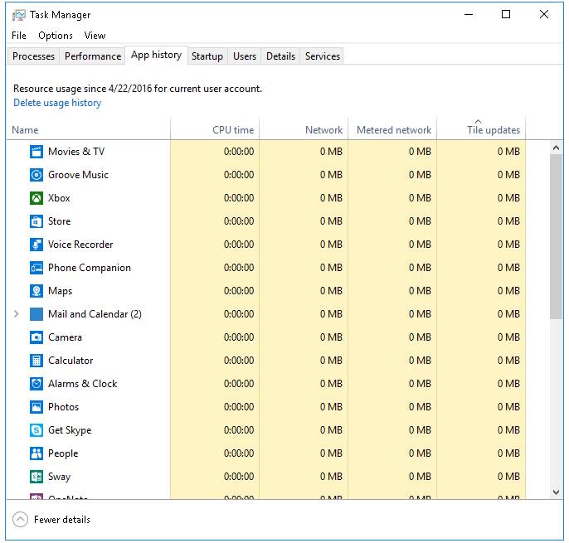
Overview of Task Manager
The App history tab shows the amount of resources running apps have consumed
Notes:
The App history tab is new, and it shows information about overall resource consumption.
20740C
12: Managing, monitoring, and maintaining virtual machine installations

Slide 18
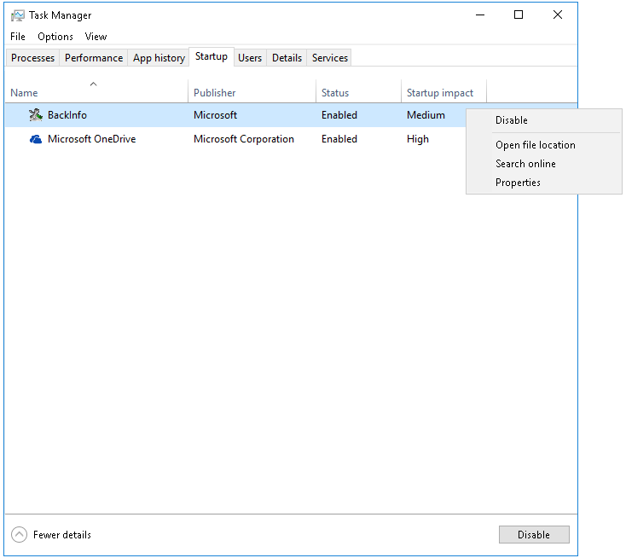
Overview of Task Manager
The Startup tab shows the applications that automatically start and allows you to manage them
Notes:
The Startup tab is new and allows some management of the apps that start automatically.
20740C
12: Managing, monitoring, and maintaining virtual machine installations

Slide 19
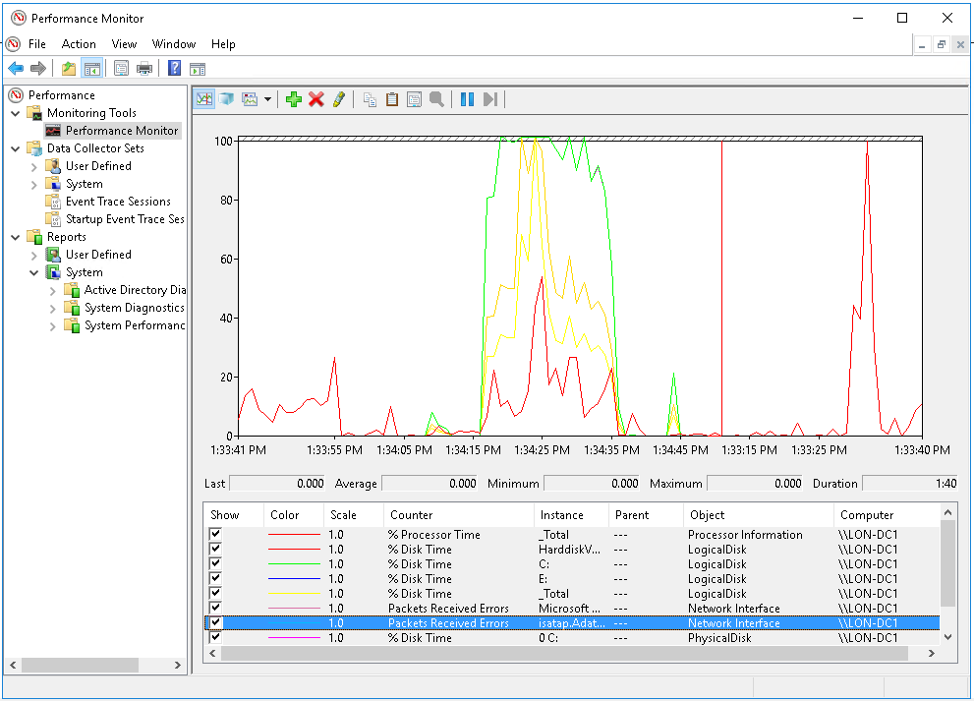
Overview of Performance Monitor
Performance Monitor enables you to view current performance statistics or historical data that data collector sets have gathered
Notes:
Note: This topic has one additional slide.
You can use Performance Monitor to examine how the programs you run affect your server’s performance, both in real time and by collecting log data for later analysis.
To access Performance Monitor, in the Performance Information and Tools page, select Advanced Tools.
You can view data through Performance Monitor by using the following:
Monitoring tools
Data collector sets
Reports
Briefly mention that you can access Resource Monitor from Performance Monitor.
Inform students that during the process of installing other applications, such as Microsoft Exchange Server or Microsoft SQL Server data management software, Windows Server adds application-specific Exchange Server and SQL Server performance counters to Performance Monitor.
20740C
12: Managing, monitoring, and maintaining virtual machine installations

Slide 20
Overview of Performance Monitor
Primary processor counters:
Processor > % Processor Time
Processor > Interrupts/sec
System > Processor Queue Length
Primary disk counters:
Physical Disk > % Disk Time
Physical Disk > Avg. Disk Queue Length
Primary network counters:
Network Interface > Current Bandwidth
Network Interface > Output Queue Length
Network Interface > Bytes Total/sec
Primary memory counter:
The Memory > Pages/sec counter
Notes:
20740C
12: Managing, monitoring, and maintaining virtual machine installations

Slide 21
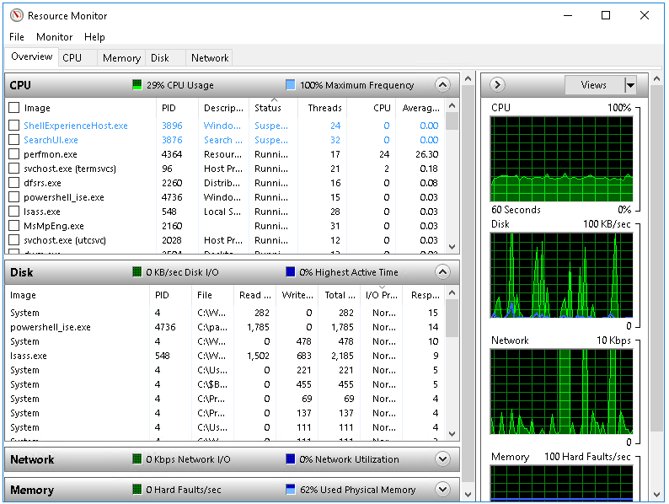
Overview of Resource Monitor
Resource Monitor provides an in-depth look at the real-time performance of your server
Notes:
Explain how the Resource Monitor interface in Windows Server 2016 provides an in-depth look at a server’s real-time performance. Explain how students can use Resource Monitor to monitor the use and performance of central processing unit (CPU), disk, network, and memory resources in real time. This enables you to identify and resolve resource conflicts and bottlenecks.
20740C
12: Managing, monitoring, and maintaining virtual machine installations

Slide 22
Overview of Reliability Monitor
Monitors hardware and software issues
Provides stability index number (from 1 to 10):
1 represents lowest stability
10 represents highest stability
The Reliability Monitor window components include:
Historical reports on stability index
Reliability details
Action to be performed: saving historical data, starting the Problem Reports console, checking online for a solution to a specific problem
Notes:
Note: This topic has one additional slide.
Explain how Reliability Monitor works, and use the Reliability Monitor console to explain the information that it makes available.
20740C
12: Managing, monitoring, and maintaining virtual machine installations

Slide 23
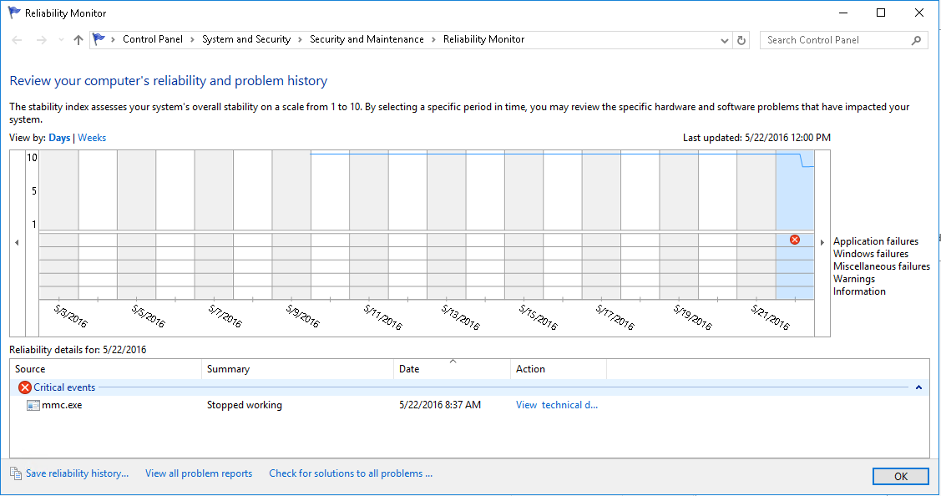
Overview of Reliability Monitor
Reliability Monitor tracks hardware and software issues that have impacted the system
Notes:
20740C
12: Managing, monitoring, and maintaining virtual machine installations

Slide 24
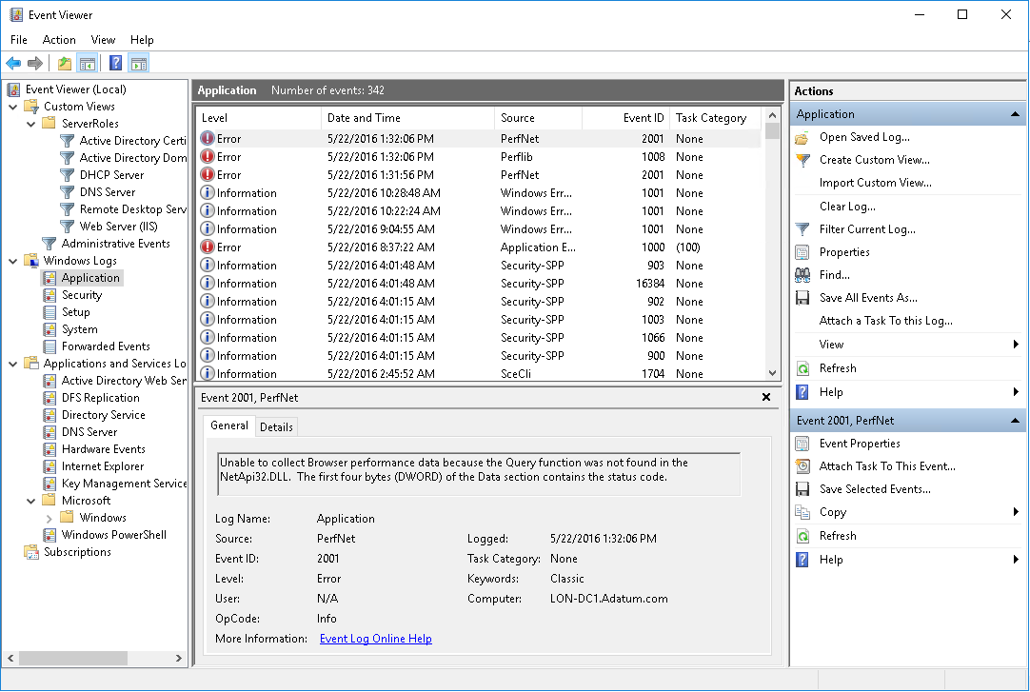
Overview of Event Viewer
Event Viewer provides categorized lists of essential Windows log events, and log groupings for individual installed applications and specific Windows component categories
Notes:
Note: This topic has one additional slide.
Most students should be somewhat familiar with Event Viewer. Consider demonstrating the Applications and Services Logs node.
20740C
12: Managing, monitoring, and maintaining virtual machine installations

Slide 25
Overview of Event Viewer
Event Viewer provides the ability to:
View multiple logs
Create customized views
Configure tasks scheduled to run in response to events
Create and manage event subscriptions
Event Viewer has many built-in logs such as:
Application log
Security log
Setup log
System log
Forwarded events
Notes:
20740C
12: Managing, monitoring, and maintaining virtual machine installations

Slide 26
Monitoring a server with Server Manager
Server Manager console:
Installed by default on Windows Server 2016, and can be installed on Windows 10
Supports monitoring of Windows Server operating systems
Provides a centralized monitoring dashboard
Analyzes or troubleshoots different types of issues
Identifies critical events
Monitors the status of Best Practices Analyzer tool
Notes:
Describe scenarios to students where they can use Server Manager to monitor servers that are running the Windows operating system. Also, show the Server Manager console to students, and demonstrate several ways to monitor information from the console.
20740C
12: Managing, monitoring, and maintaining virtual machine installations

Slide 27
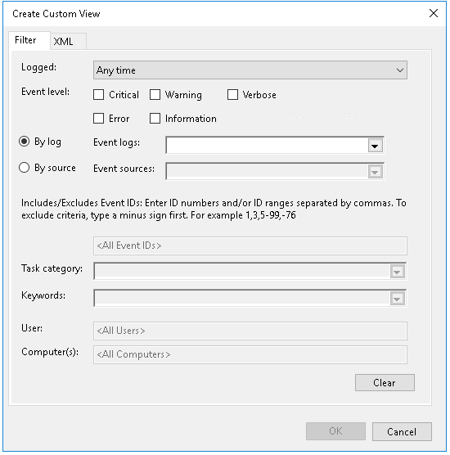
What is a custom view?
Custom views allow you to query and sort just the events that you want
to analyze
Notes:
Remind students that event logs contain vast amounts of data, and it could be challenging to narrow the set of events to just those that are of interest.
20740C
12: Managing, monitoring, and maintaining virtual machine installations

Slide 28

What are event log subscriptions?
Event subscriptions allow you to collect event logs from multiple servers, and then store them locally
Notes:
Explain that Event Viewer includes the ability to collect copies of events from multiple remote computers, and then store them locally. You can create an event subscription to specify which events to collect and in which log to store them. After a subscription is active and events collection begins, you can view and manipulate these forwarded events as you would any other locally stored events.
Explain that before you can create a subscription to collect events on a computer, you must configure the collecting computer (the collector) and each computer from which events will be collected (the source).
20740C
12: Managing, monitoring, and maintaining virtual machine installations

Slide 29
Using Server Manager to view event logs
Server Manager provides a centralized location for event logs from remote servers
Event logging
Enabled by default
Categorized by technology: AD DS, DNS, and Remote Access
Customized views
Create queries for specific types of events that need to be displayed
Configure event data that needs to be displayed
Notes:
Explain to students the scenarios in which you would use Server Manager for viewing event logs from different remote Windows servers. Also, display the Server Manager console to students, and demonstrate how you can monitor event log information from the console.
20740C
12: Managing, monitoring, and maintaining virtual machine installations

Slide 30
Lab B: Monitoring and troubleshooting Windows Server 2016
Exercise 1: Establishing a performance baseline Exercise 2: Identifying the source of a performance problem Exercise 3: Viewing and configuring centralized event logs
Logon Information
Virtual machines: 20740C-LON-DC1
20740C-LON-SVR1
User name: Adatum\Administrator
Password: Pa55w.rd
Estimated Time: 60 minutes
Notes:
Exercise 1: Establishing a performance baseline
In this exercise, you will use Performance Monitor on the server, and create a baseline by using typical performance counters.
Exercise 2: Identifying the source of a performance problem
In this exercise, you will simulate a load to represent the system in live usage, gather performance data by using your data collector set, and then determine the potential cause of the performance problem.
Exercise 3: Viewing and configuring centralized event logs
In this exercise, you will use LON-DC1 to collect event logs from LON-SVR1. Specifically, you will use this process to gather performance-related alerts from your network servers.
20740C
12: Managing, monitoring, and maintaining virtual machine installations

Slide 31
Module Review and Takeaways
Review Questions Tools Best Practices Common Issues and Troubleshooting Tips
Notes:
Review Questions
Question
Your manager has asked if all updates to the Windows operating system should be applied automatically upon release. Do you recommend an alternative process?
Answer
You should test all updates before applying them in a production environment. That is, you should first deploy updates to a set of test computers by using WSUS.
Question
Your organization implements several applications that are not Microsoft applications. A colleague has proposed using WSUS to deploy application and operating system updates. Are there any potential issues with using WSUS?
Answer
Yes. WSUS is an excellent tool for deploying updates for Microsoft applications such as the Microsoft Office system and Windows operating system updates. However, WSUS does not deploy updates for all Microsoft applications, and it does not deploy updates for non-Microsoft applications. System Center 2012 Configuration Manager is a better choice when you need to deploy updates for non-Microsoft applications.
Question
Why is WSUS easier to manage in an Active Directory Domain Services (AD DS) domain?
Answer
WSUS takes advantage of the AD DS organizational unit (OU) structure for deploying client settings through Group Policy. You can also use Group Policy settings to configure client-side targeting to determine the WSUS group membership of a client computer.
20740C
12: Managing, monitoring, and maintaining virtual machine installations
(More notes on the next slide)

